Slide 1
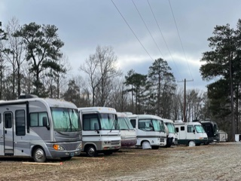
Recreational Vehicle Storage
Limited Spaces Available
Outdoor Recreation offers a limited number of outdoor storage spaces for a variety of recreational vehicles.
*Boats
*Utility & Cargo Trailers
*Motorhomes
*Travel Trailers
*Passenger vehicles must be stored on a trailer
All personal property stored in our lot must have current registration, proof of insurance and be “roadworthy” at all times.
2021/2022 Pricing
Under 30 feet- $45 per month
Over 31 feet- $65 per month
Advance payment of 12 months with cash, credit, debit or check receive 1 month FREE!
As of December 2021 all monthly storage agreement fees will be collected via automated debit.
Call or email us for more details or to be added to the waiting list
678-655-4870 94fssodr@gmail.com

