Slide 1
FSV
UNITE PROGRAM
Discussion
Both ends of track
Weather & Safety protection. Outfitted with, lightning arrestor system, lights & “Big Ass Fan”
Fitness Testing Particularly, when weather conditions are not favorable.
THE USAFA UNITE PROGRAM IS A UNIT RESILIENCY PROGRAM OPEN TO ACTIVE DUTY, RESERVISTS, AND APF/NAF CIVILIANS. THE PROGRAM WILL CONDUCT ON AND OFF-BASE EVENTS WHILE ADHERING TO ALL STATE, COUNTY, AND BASE LEVEL COVID-19 SAFETY GUIDELINES AND REQUIREMENTS.
In August 2016, Air Force Chief of Staff (CSAF) General David Goldfein, released his letter to Airmen titled, "The Beating Heart of the Air Force…Squadrons!“ In turn, AFSVA was asked to establish an activity rich program that would equip empowered Squadron/Unit commanders with options to facilitate unit cohesion. Unite provides commanders with funding to initiate programs that will benefit all Airmen in their unit. This includes assigned Active Duty and APF/NAF Civilians.
94TH FSS

Slide 2
FSV
UNITE PROGRAM
ELIGIBILITY
UNITE EVENTS MUST BE INCLUSIVE TO ALL AIRMAN IN AN ORGANIZATION
THIS INCLUDES ACTIVE DUTY, RESERVES, APF AND NAF CIVILIANS AND CANNOT BE DIVIDED BASED
ON RANK, PAY, GRADE, AGE, RACE, GENDER OR RELIGION.
FUNDING
The installation C3 can confirm your allocations and will make payments on your behalf.
RECREATION FUNDS (APF) CY22 $13.50 pp May be used on equipment rentals, program supplies and decorations*. *Decorations cannot exceed 5% of event cost.
FOOD & BEVERAGE FUNDS (NAF) CY22 $5.00 pp Must be used in conjunction with a Unite event. No alcohol.
Example: Unit can submit for Laser tag @ $13.50 pp Food @$5.00pp
FUNDING GUIDELINES
Unite is NOT a food & beverage program
Events must be recreational and cohesive to utilize funding
Unite funds CANNOT be combined with other NAFs or APFs
Funds from non-Federal entities such as Booster Clubs may be used
UNAUTHORIZED PURCHASES
Alcohol
Gambling
Lodging or transportation
Equipment (rentals allowed)
Prizes, giveaways or promo items
Porta-Johns, trash services, damages or cleaning fees
UNAUTHORIZED EVENTS
Holiday parties
End of year events
Balls or banquets
Dining in/Dining outs
Squadron trainings or meetings
Base wide special events
Movies, concerts, mystery theater, or amusement parks
94TH FSS
NOTE: Family members are welcome to participate, but they must pay any associated fees.

Slide 3
FSV
UNITE PROGRAM
Funding Information
✘ APF (MOA) Dollars (Activity Funds): $13.50/person Equipment rentals, program supplies (Paper Plates, Cups, Utensils, Napkins, Charcoal Decorations (5% of budget), Foil, Foil Pans, Room Fees, Pavilion/Equipment Rentals, and entertainment.
If a squadron has 100 total people with days, (day & night) workers. They have a program asking for $13.50 in APF and $500 in food but worker from day or night can’t attend. Is this authorized? NO. Funding is based on those attending.
✘ NAF Dollars (Food Funds): $5/person Food and beverage Must be used with a UNITE event.
No alcohol.
✘ The UNITE program is activity, and NAF dollars are an added benefit. NAF funds must be directly in conjunction with an approved UNITE event. An event centered on just eating without an approved Unite cohesive and or team building event is NOT authorized and will not be approved.
94TH FSS

Slide 4
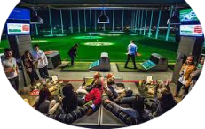
FSV
UNITE PROGRAM
Example of Events
Examples of Unite approved events.
94TH FSS
Top Golf
Groups 10-15

Slide 5
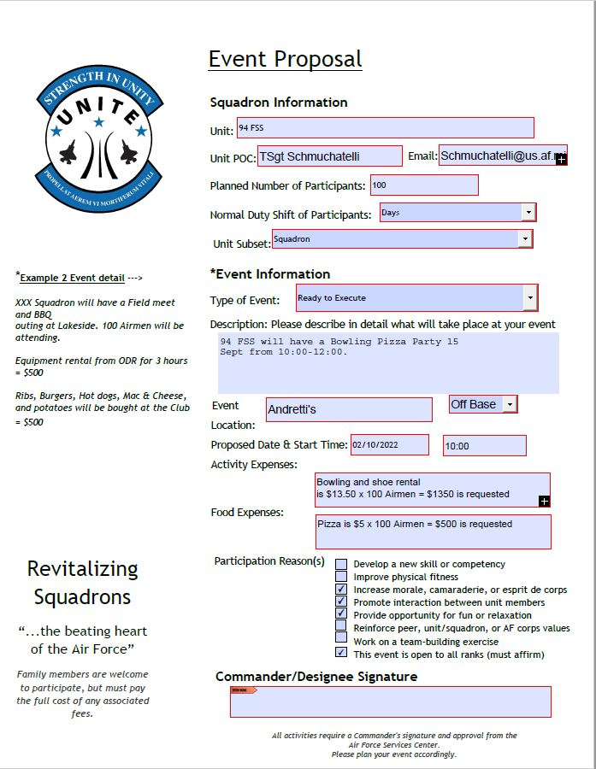
FSV
UNITE PROGRAM
HOSTING YOUR
FIRST UNITE EVENT
Please provide a Unit POC. Primary and alternate. This required.
94TH FSS

Slide 6
FSV
UNITE PROGRAM
HOSTING YOUR FIRST UNITE EVENT
Designate unit representatives (required) in writing to build a relationship with the Unite C3. Suggested: Primary (Fulltime staffer) Alternate (Reservist).
Have your unit POC contact 94 FSS Unite C3: 94FSS.SVC.MWR@us.af.mil , Brad Fallin 655-4872.
Event Proposal: Have your unit POC complete the event proposal form & the Unite C3 will submit it to the USAFA C3. AFSVA event approval may take from 21-30 days.
Have Fun at Your Event!
Submit After-Action Report: Have your unit representative & Unite POC submit an after-action report with (5) pictures within 5 business days.
94TH FSS

